Slide 1
Linguistics 200, Day 4
Culture Pitches

Slide 2
What we’ll doing today
Briefly present your culture to the class
Overview of Component 1 -- what will it look like?

Slide 3
What we’ll doing next time
Developing your culture further
Work on a short story, poem, song, or any form of short media about your culture (due next Monday)

Slide 4
For Monday
Be sure to watch all three intro videos & do the readings!
https://uk.instructure.com/courses/2111202/modules

Slide 5
Culture Pitches
LIN 200 Honors (F24).whiteboard

Slide 6
Component One
In this component, you'll be establishing the world in which your ConLang exists. Now is the time to get creative!
For each project component, you'll be working within a Onedrive doc, which you'll access here.
For this component you will:
Edit the docx to answer the questions listed in "Component 1". There is no need (or way) to submit a file on Canvas.
Delete any instructions so that each number only includes your answers.
If you have a question, @ Dr. Byrd in the docx or in Discord.

Slide 7
Linguistics 200, Day 5
Developing Your Culture Further

Slide 8
Friendly reminder about assignments & presentations

Slide 9
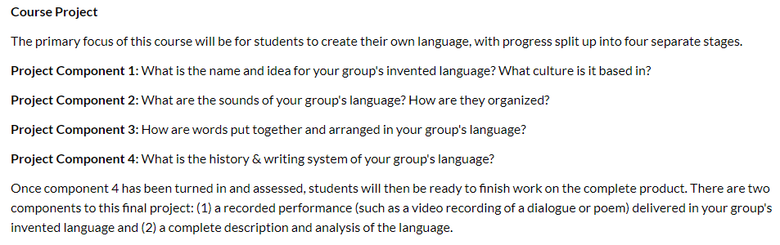

Slide 10
Reminder: Component One
In this component, you'll be establishing the world in which your ConLang exists. Now is the time to get creative!
For each project component, you'll be working within a Onedrive doc, which you'll access here.
For this component you will:
Edit the docx to answer the questions listed in "Component 1". There is no need (or way) to submit a file on Canvas.
Delete any instructions so that each number only includes your answers.
If you have a question, @ Dr. Byrd in the docx or in Discord.

Slide 11
For next time (Monday)
Be sure to watch all three intro videos and do the readings!
https://uk.instructure.com/courses/2111202/modules

Slide 12
What we’ll doing today
Developing your culture further
Beginning work on a short story, poem, song, or any form of short media about your culture (due next Monday)

Slide 13
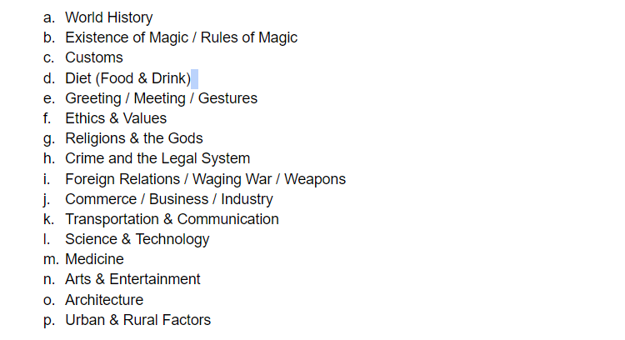
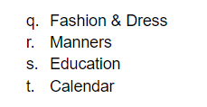
If there's time...

